Slide 1
Academic Success A Dive Into Effects on the Success of K-12 US Public Schools
Paper Straws.LLC

Slide 2
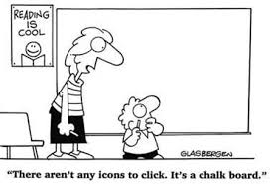
Overview of Project
Questions To Ask
Other Variables to Look at
Even More Considerations

Slide 3
Generic Graph/Information

Slide 4
Question and Motivation
Step 1 Title
Task description
Task description
Task description
Task description
Step 2 Title
Task description
Task description
Task description
Step 3 Title
Task description
Task description
Step 4 Title
Task description
Task description

Slide 5
Contextual Facts
First bullet point here
Second bullet point here
Third bullet point here
Class | Group 1 | Group 2
Class 1 | 82 | 95
Class 2 | 76 | 88
Class 3 | 84 | 90

Slide 6
Datasets and Locations

Slide 7
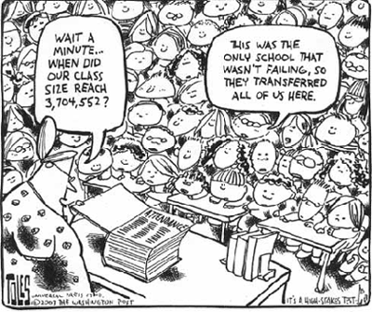
Data Wrangling, Clean-up, and Explanation

Slide 8
Clean Up

Slide 9
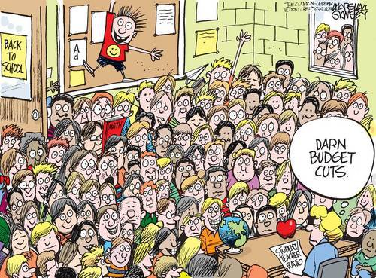
Analysis

Slide 10
Analysis

Slide 11
Conclusions and Implications

Slide 12
Conclusion

Slide 13
Graphs and Visualizations

Slide 14
Implications

Slide 16
Citations

